Slide 1
Computer Security Cryptography (1/3)
by Akkradach W.
Dept. of Computer Engineering
KMITL

Slide 2
The Protection
Time VS Value
Direct benefits
Confuse unauthorized people
Confirm authorized people
Indirect benefits
Integrity checking
Authentication

Slide 3
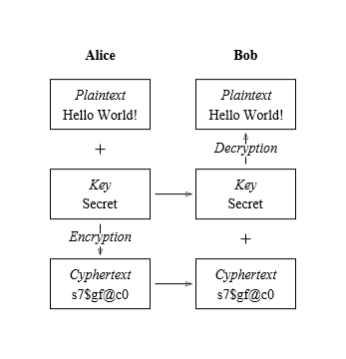
Cryptology
Cryptography is the practice and study of hiding information.
Cryptanalysis is the study of methods for obtaining the meaning of encrypted information.

Slide 4
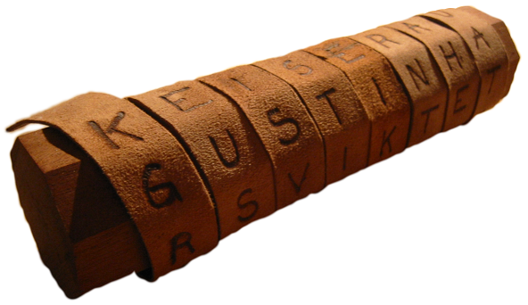
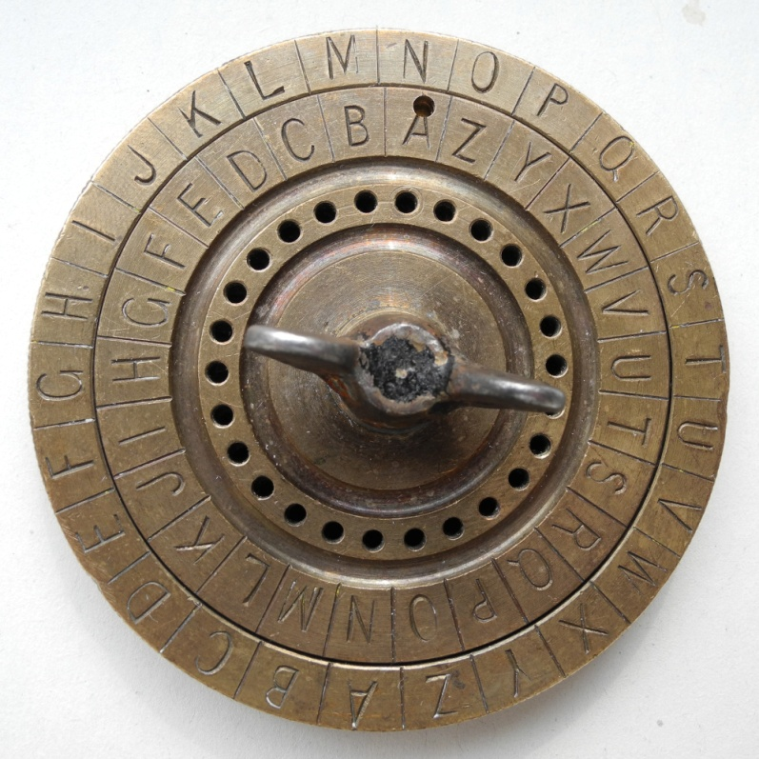
Classic Cryptos
Scytale
Caesar Cipher

Slide 5
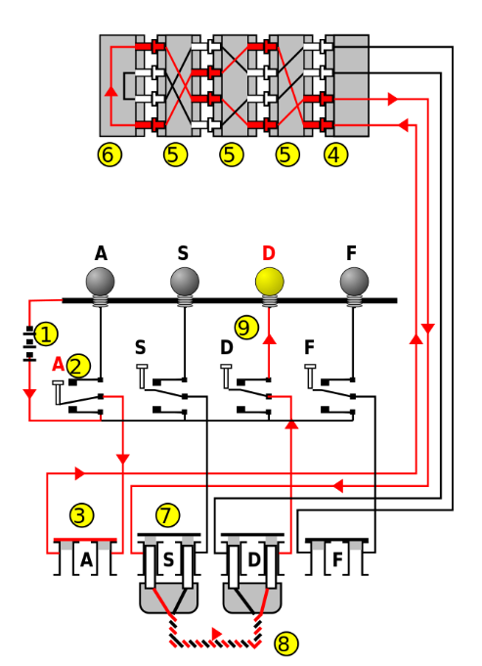
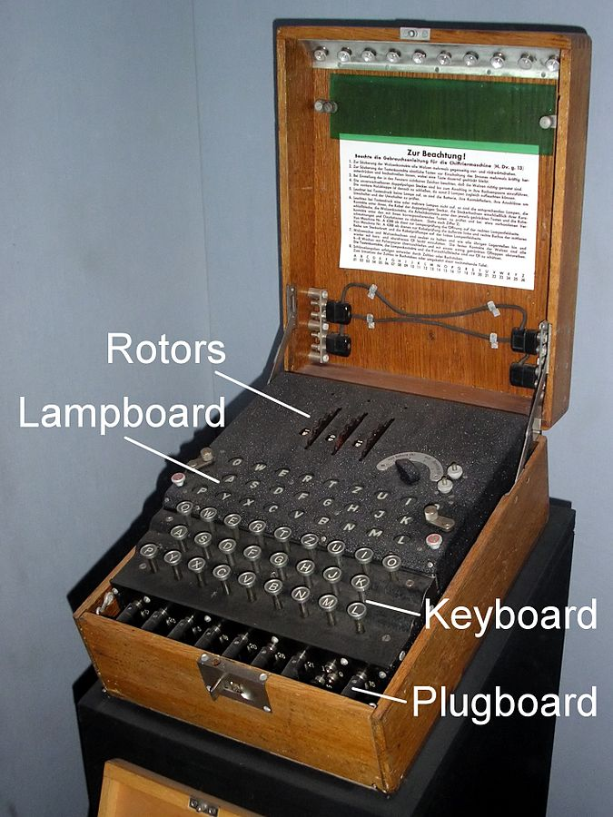
Classic Crypto Device
Enigma Machine

Slide 6
Modern Cryptos
Symmetric/Secret Key Cryptography
Decipher() = Encipher()⁻¹
DES (p{64}:k{56})
3DES (p{64}:k{112|168})
c = E(D(E(p,k₁),k₂),k₃)
p = D(E(D(c,k₃),k₂),k₁)
AES (p{128}:k{128|192|256})
Asymmetric/Public Key Cryptography

Slide 7
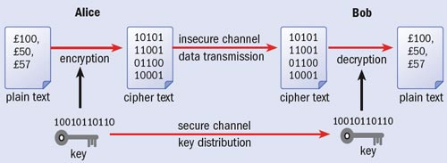
Physical Crypto
Quantum Cryptography
Quantum Key Distribution (QKD)
Polarization of Photon
No-cloning theorem

Slide 8
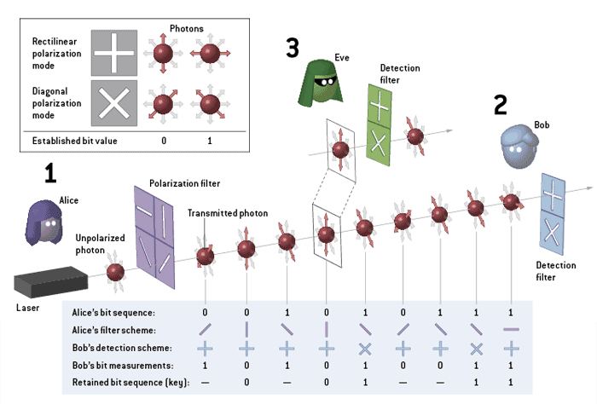
QKD (1/2)

Slide 9

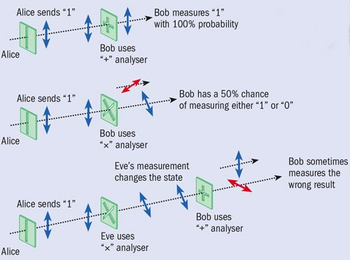




QKD (2/2)
Alice sends
Bob chooses
Bob gets
Bob and Alice exchange
They share

Slide 10
Foundation
Substitution Cipher
Permutation Cipher
One-Time Pad
Stream Cipher
Block Cipher
Iterated Block Cipher
Modular Arithmetic
Totient Function VS Prime Factorization
Multiplicative Inverse VS Discrete Logarithm

Slide 11
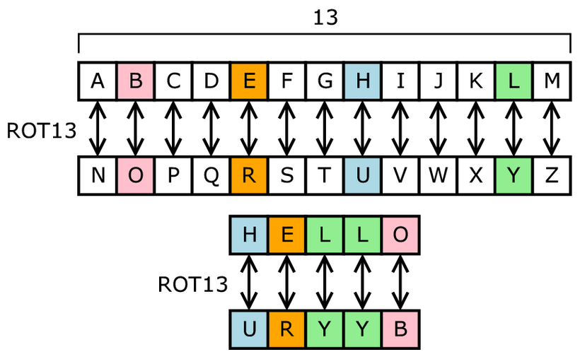
Substitution Cipher

Slide 12
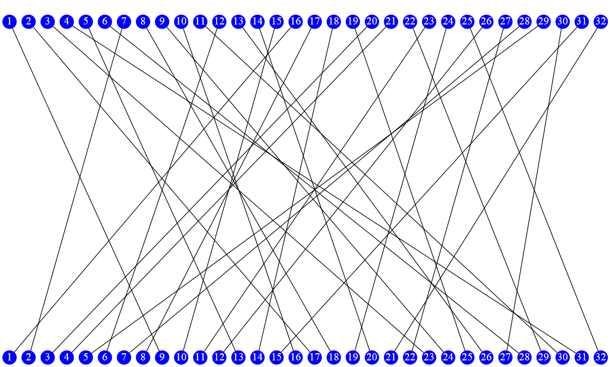
Permutation Cipher

Slide 13
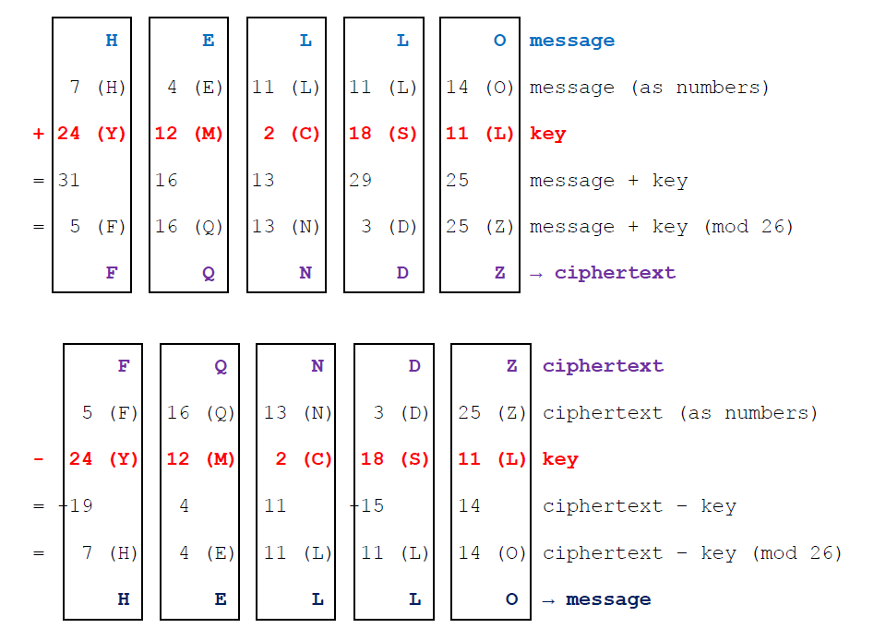
One-Time Pad

Slide 14
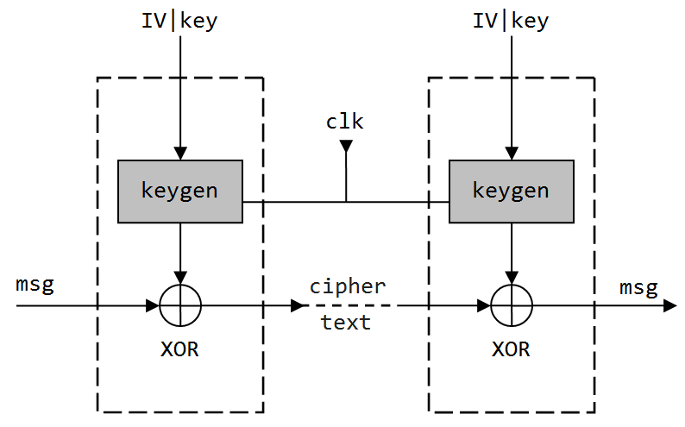
Stream Cipher

Slide 15
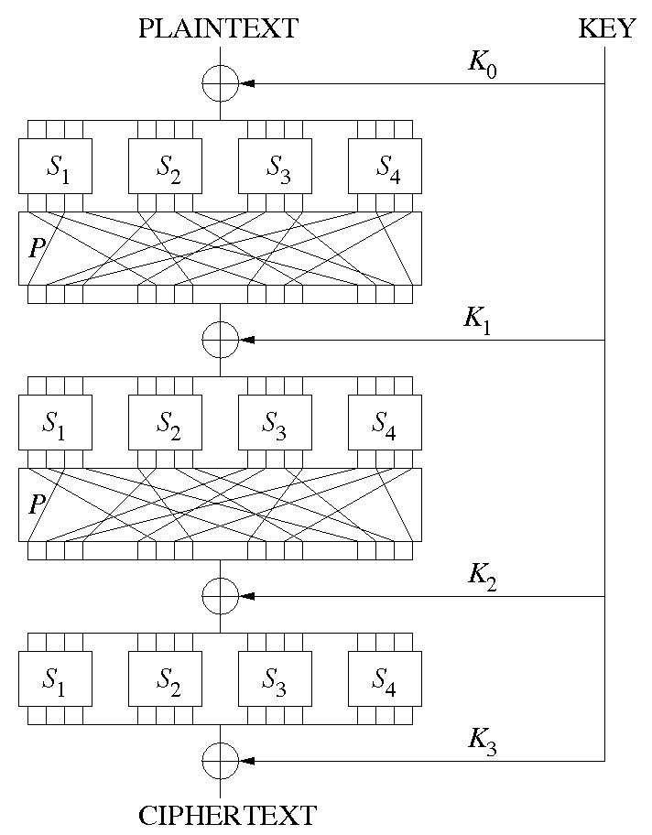
Block Cipher
|p_{i}|=|K_{0..n}|=|c_{i}|
KEY gives K₀ .. K_{n}
S_{x} are substitutions
P is permutation
How to decipher?

Slide 16
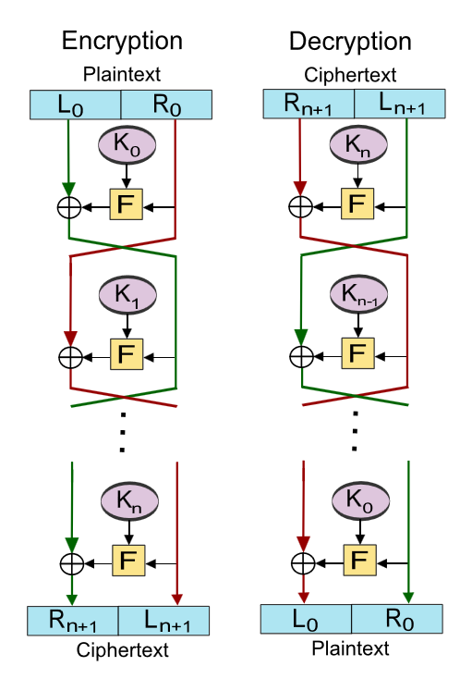
Feistel Cipher
Encipher
p = L₀ | R₀
L_{i+1} = R_{i}
R_{i+1} = L_{i} ⊕ F(R_{i},K_{i})
Decipher
c = R_{n+1} | L_{n+1}
R_{i} = L_{i+1}
L_{i} = R_{i+1} ⊕ F(L_{i+1},K_{i})

Slide 17
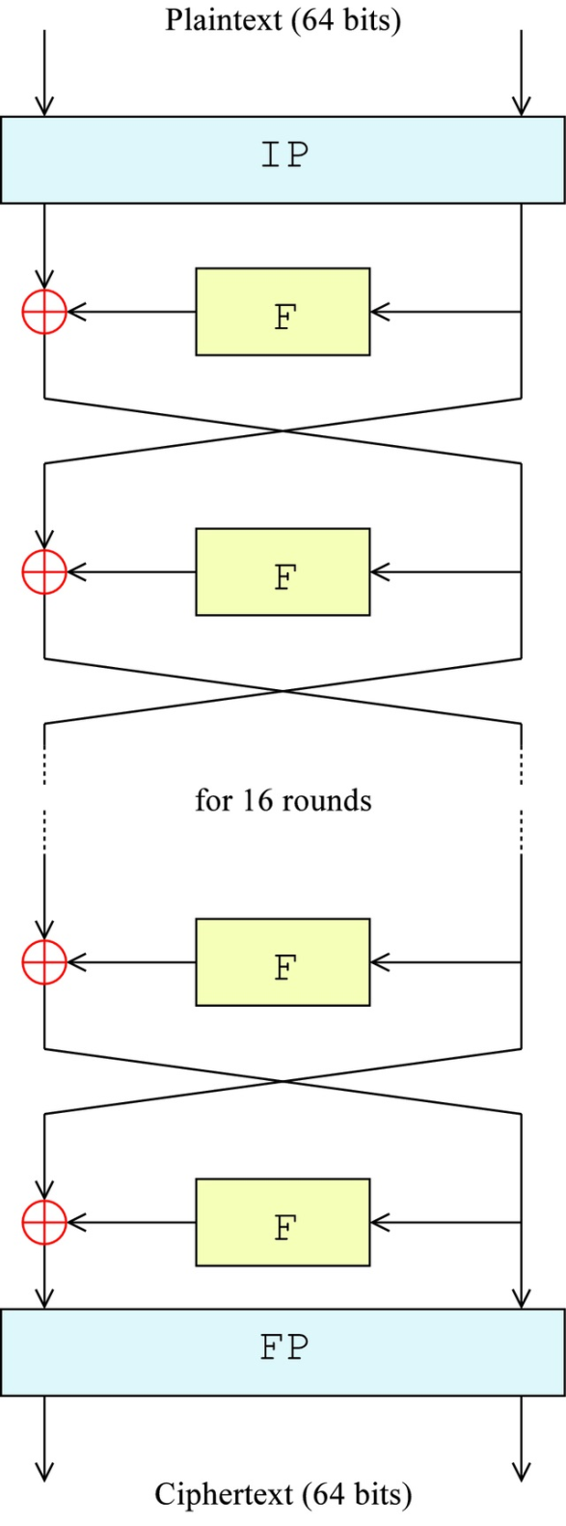
DES : Overall (1/3)
|Data| = 64 bits
|Key| = 56 bits (why?)
IP = FP⁻¹
How to decipher?

Slide 18
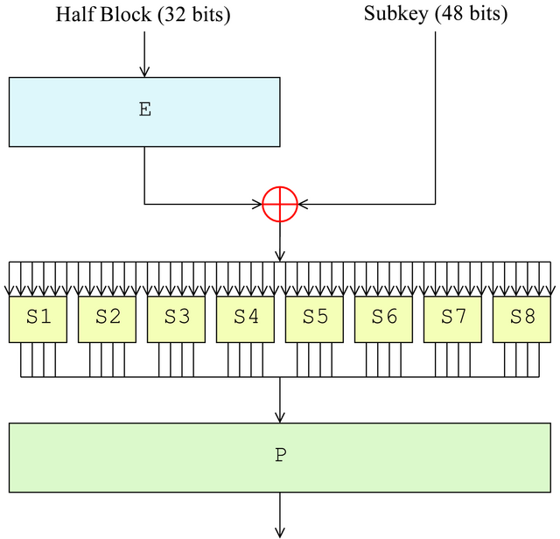
DES : Feistel Function (2/3)
Expansion
32-bits TO 48-bits
S-Box_{1..8}
6-bits TO 4-bits

Slide 19
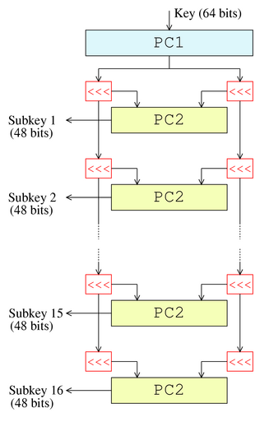
DES : Key Schedule (3/3)
Key & Subkeys
PC1
64-bits TO 56-bits
56-bits TO two 28-bits
PC2
28-bits TO 24-bits
Two 24-bits TO 48-bits

Slide 20
How secure is DES?
DES is NOT secure because ..
56-bit key is too short!
NSA's involvement in the design of S-Box!
So .. how do we survive?
How many bits are the proper secret key?
What/Who can we trust?

Slide 21
つづく

